Slide 1
Household Load forecasting Based on Machine Learning Algorithm

Slide 2
Introduction
Electric Load forecasting enables revenue load forecasting which facilitates power system energy trading, aids in scheduling operations.
Accurate Load forecasting using three modelling system such as LSTM(RNN),Prophet, SVR and ARIMA.
The residential load short-term forecasting took place through transfer learning and meta-learning solutions.

Slide 3
Model Selection
The ARIMA and SVR function effectively yet they lack the ability to identify non-dynamic along with non-linear consumption patterns.
Neural Networks (NNs) represent the most researched forecasting method because they deliver superior accuracy levels.
The issues of long-term dependency learning and forecasting performance optimization were solved by LSTM networks and deep recurrent neural networks.
Prophet is displays for holidays, trends and seasonality

Slide 4
Problem Statement
Research about incorporating renewable power sources into residential load prediction remains limited even after recent enhancements.
The research establishes a connection between deep learning-based load forecasting and renewable energy analysis by implementing renewable energy considerations.

Slide 5
Research Aim & Objectives
The aim of the study is to forecast of household load using advanced deep leaning models.
To use advanced deep learning model to forecast household load and optimize model’s efficiency and accuracy.
To compare different forecasting methodologies such as ARIMA, SVR, Prophet, and LSTM(RNN).
To analyse the impact of the integration of renewable energy on forecasting accuracy.

Slide 6
Literature Review
Examines existing research on load forecasting methodologies and their performance when forecasting energy consumption at the household level.
The application of SARIMA extends ARIMA capabilities through seasonal trend inclusion for cases where daily or monthly electricity usage patterns need modelling.
Support Vector Regression (SVR) together with Linear Regression (LR) to establish links between independent factors of weather and time along with historical usage patterns thereby operate with multiple variables and provide higher flexibility than ARIMA models when dealing with non-linear patterns.
Standard models such as ARIMA and SVR are popular but cannot capture non-linearity and high volatility of residential electricity usage. Machine learning models such as SVM and ANN offer improvements in pattern identification but are not sufficient when capturing sequential dependencies

Slide 7
Methodology
This study focusses to examine residential consumption patterns of electricity, predict future load profiles, and evaluate behavioral reactions to smart meter pilots based on pre- and post-survey data.
The methodology combines quantitative data analysis with qualitative analysis based on survey data through sophisticated data processing, time-series forecasting methodologies, and visualization to extract actionable insights.

Slide 8
Data Collection
The dataset consist power consumption of households starting from 2009 January to 2010 June, saved in six individual files in text format, each representing a subset of total homes or time frame.
The study entailed two standardized surveys aimed at assessing behavioral reactions to the installation of intelligent meters.
Pre-trial Survey: The survey was carried out prior to installing smart meters to set baseline attitudes towards energy use, desire to adopt energy-saving habits, familiarity with renewable sources such as solar panels, and overall energy habits.
Post-trial Survey: Conducted after a certain duration of experience with smart metering, it measured changes in behavioral habits, attitudes, and awareness on energy consumption representing the effect of the trial of the smart meter

Slide 9
Architecture
Begin
Smart Meter Data
Time Series
Aggregate raw data
Prophet
LSTM
SVM
ARIMA
Forecasting Results

Slide 10
Data Cleaning
Data Type Convert: The readings of consumed values were initially taken as strings and converted to numerical data that can be utilized for arithmetic. String-formatted date and time fields were also converted into pandas datetime objects.
Renamed Headers: For readability and to ease understanding of the purpose, cryptic or nondescript headers were renamed to descriptive headers.
Date Indexing: The data underwent indexing to handle time-based functions such as trend examinations and rolling mean calculations and forecast production through the date column.

Slide 11
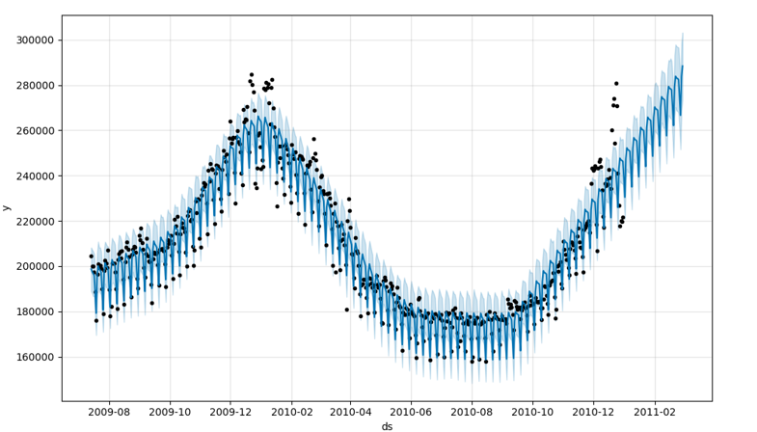
Data Visualisation
Daily load line charts over time display long-term trends like increasing or decreasing consumption that may be due to seasonal changes or behavioural patterns, which is helpful for seeing week-to-week, month-to-month, or year-to-year behavior.
The boxplot method helps identify unexpected high or low consumption patterns because they might signal measurement mistakes or specific unusual events.

Slide 12
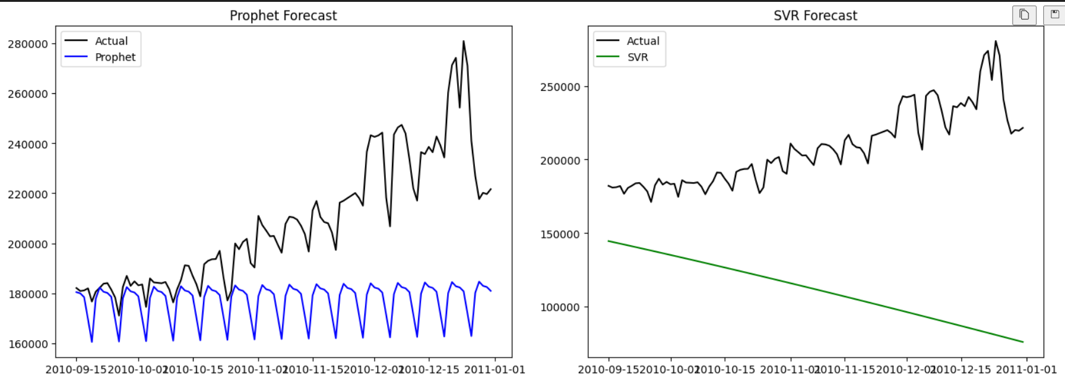
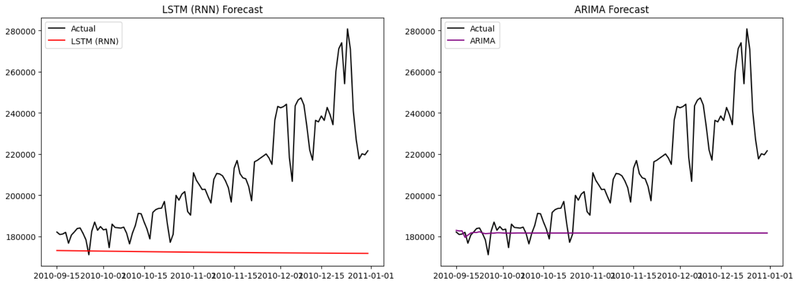
Results

Slide 13
Results
Metrics | SVR | RNN(LSTM) | ARIMA | Prophet
RMSE | 106681.52 | 44181.73 | 36795.48 | 36616.96
MAE | 97055.74 | 35847.24 | 27288.84 | 31219.83
NRMSE | 0.9721 | .4026 | .3353 | .361005

Slide 14
Conclusion
This research aimed to investigate household electricity load prediction with state-of-the-art deep learning models and compare these against traditional statistical models, and investigate how renewable energy incorporation impacts prediction accuracy.
The research also used survey-based behavioral insights to determine the people aspect of energy usage patterns and smart energy technology adoption.
The findings uncover several major conclusions that are relevant to both the research area of energy forecasting and the day-to-day practices of utility companies, policymakers, and energy managers.

Slide 15
Limitations and Areas for Future Research
Data integration: Time series modeling integrated with behavior, environment, and policy data will produce more complete and actionable predictions.
Consumer participation: Taking advantage of the strong propensity to change behavior, utility companies can use smart feedback systems, gamification, and customized incentives in order to induce energy savings.
Policy design: Mitigating barriers to renewable uptake most notably cost and complexity using subsidies, financing measures, or local programs has the potential to unleash big shifts to clean energy.
Model innovation: Investigation into state-of-the-art architectures like Transformers, Graph Neural Networks, or ensemble hybrid models has the potential to advance the accuracy of forecasts to new heights.

